Slide 1
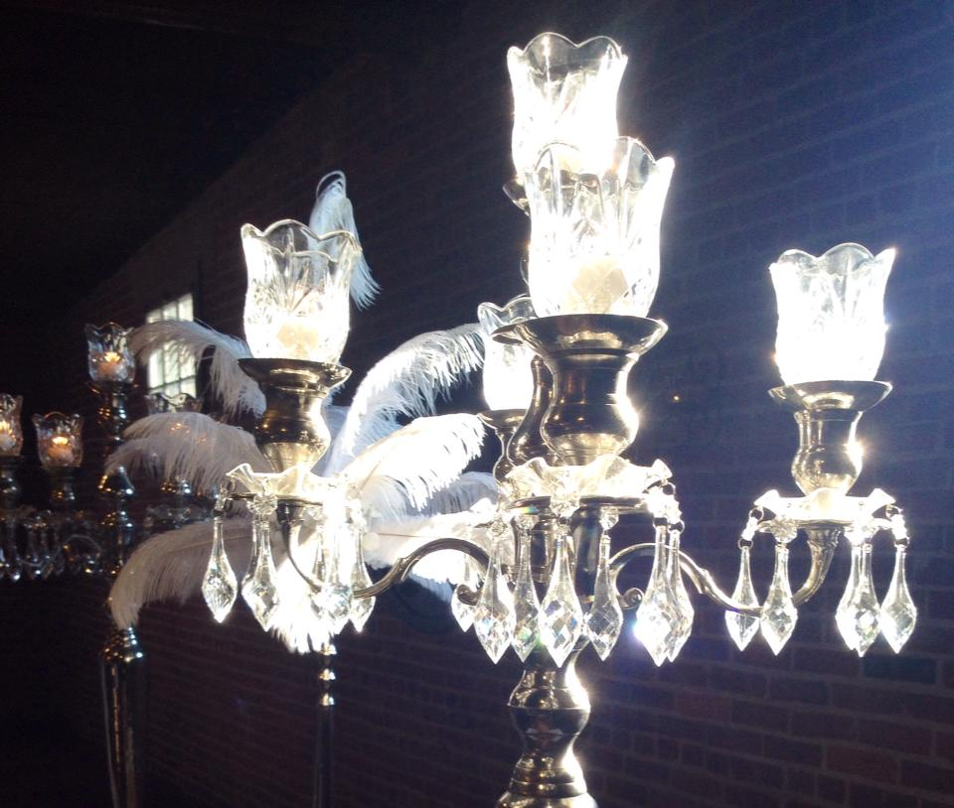
Janet Salisbury & Dakarai Wallace
Ice House Alley Warehouses
Jackson, Mississippi
September 6, 2014
A Grand Affair –Marvin Jeter & Associates

Slide 2
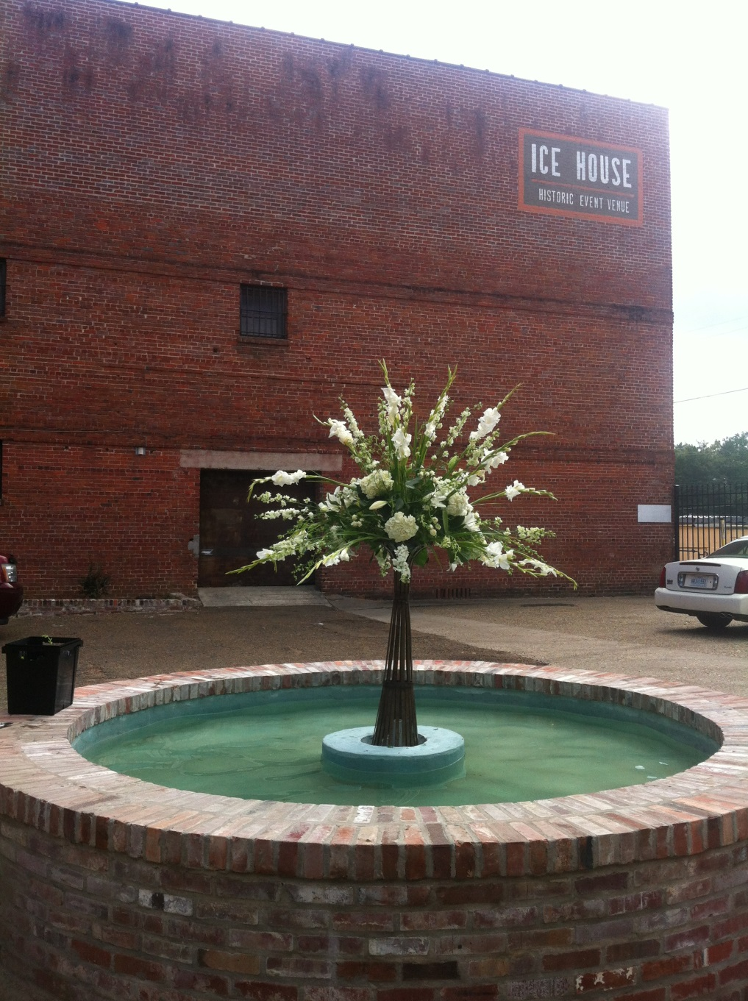
Janet Salisbury & Dakarai Wallace
A Grand Affair –Marvin Jeter & Associates

Slide 3
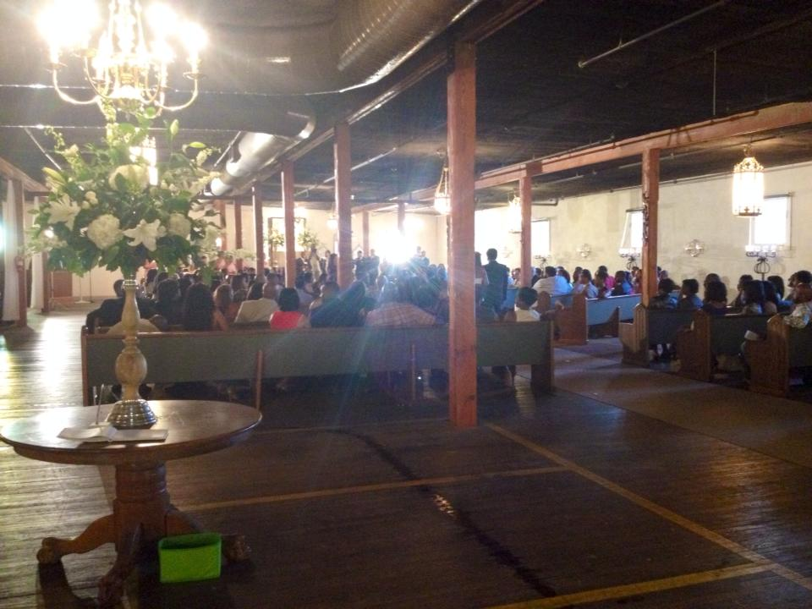
Janet Salisbury & Dakarai Wallace
A Grand Affair –Marvin Jeter & Associates

Slide 4
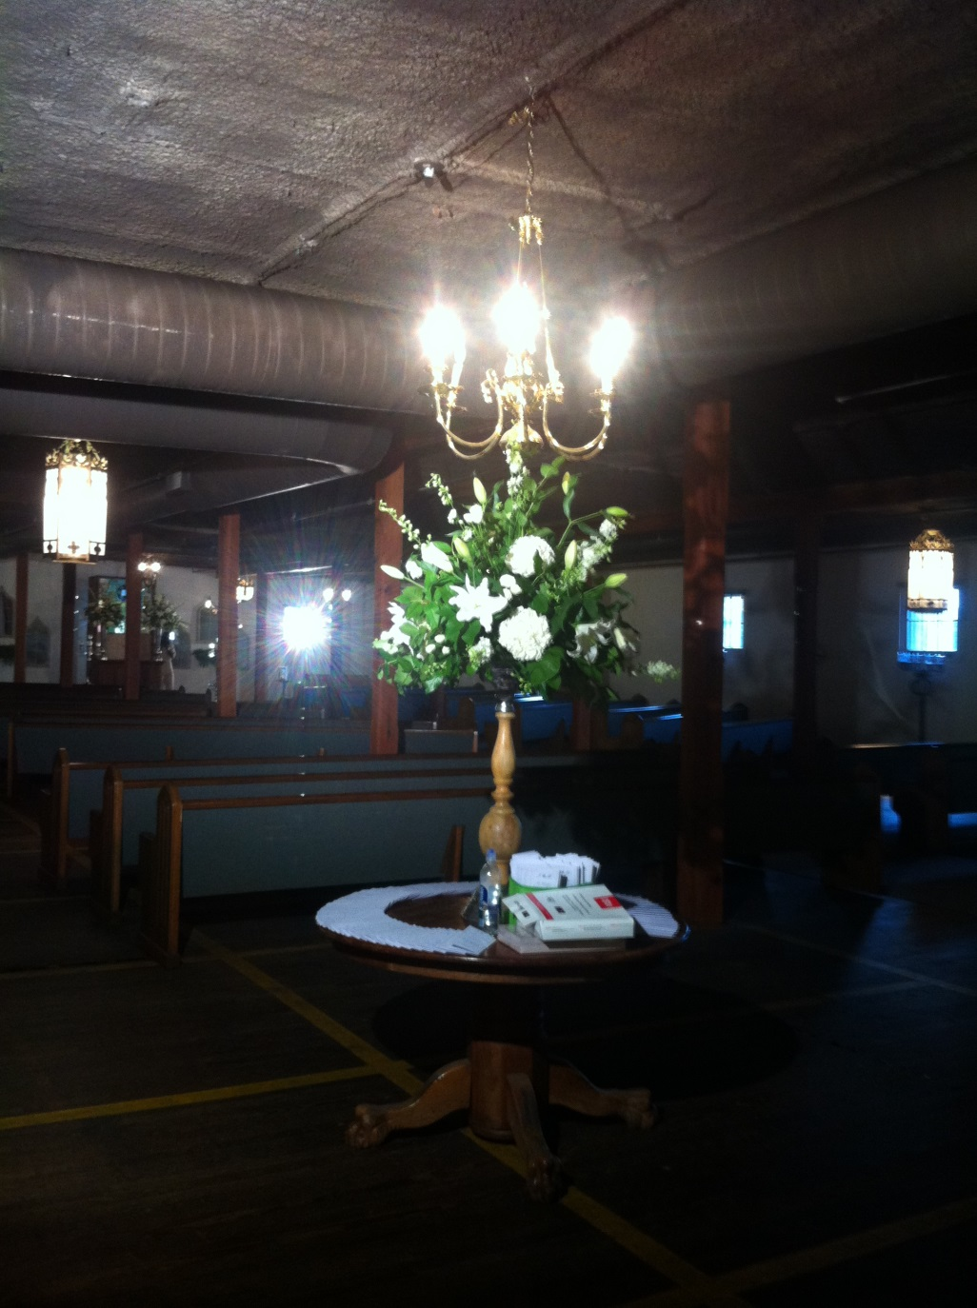
Janet Salisbury & Dakarai Wallace
A Grand Affair –Marvin Jeter & Associates

Slide 5
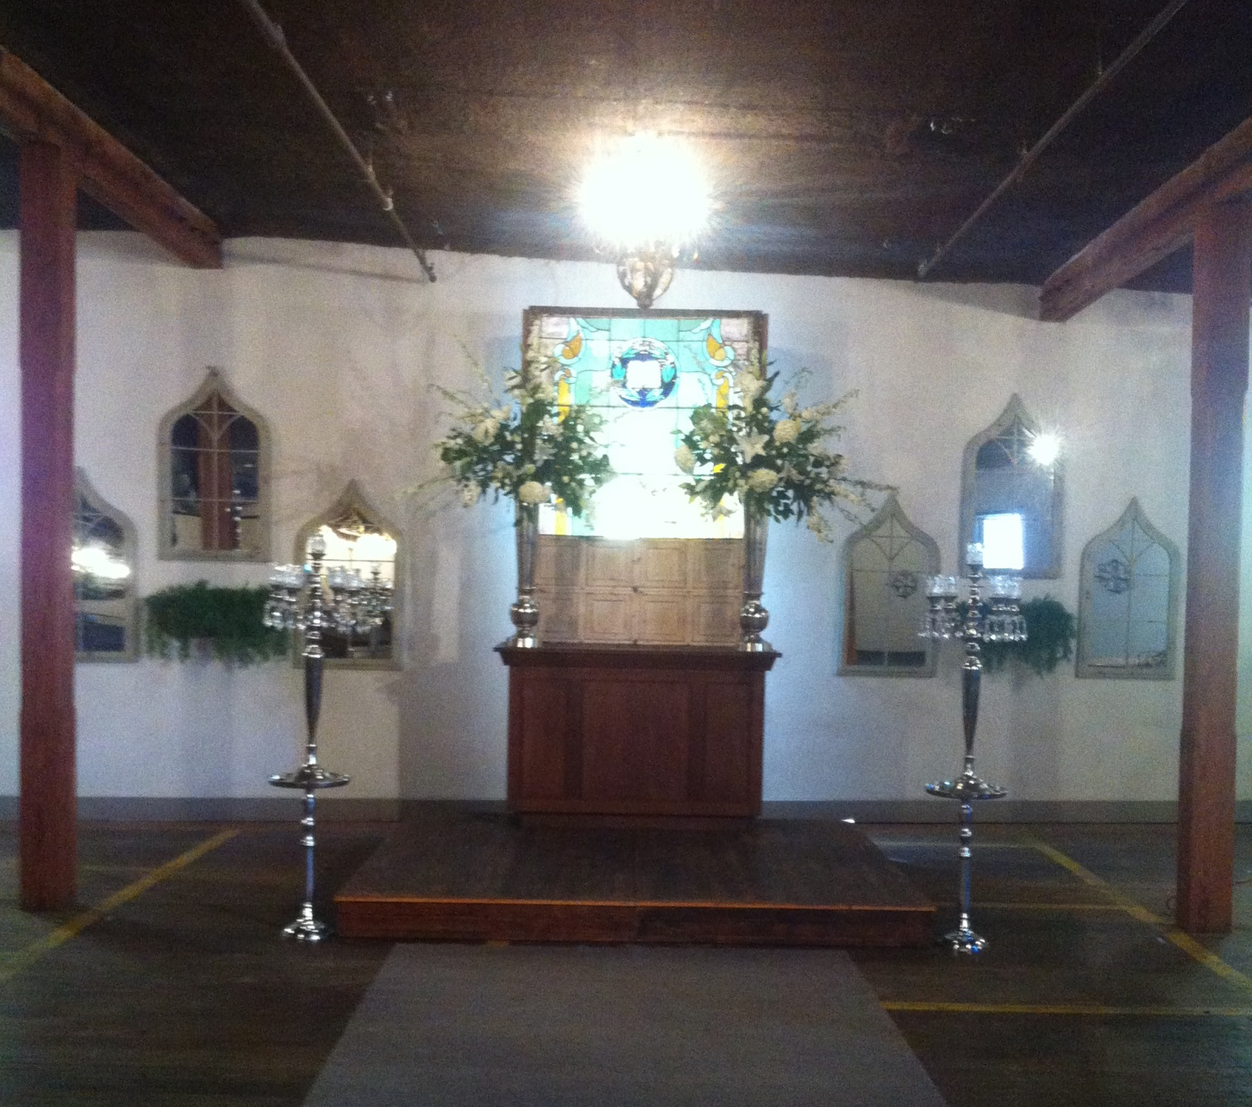
Janet Salisbury & Dakarai Wallace
A Grand Affair –Marvin Jeter & Associates

Slide 6
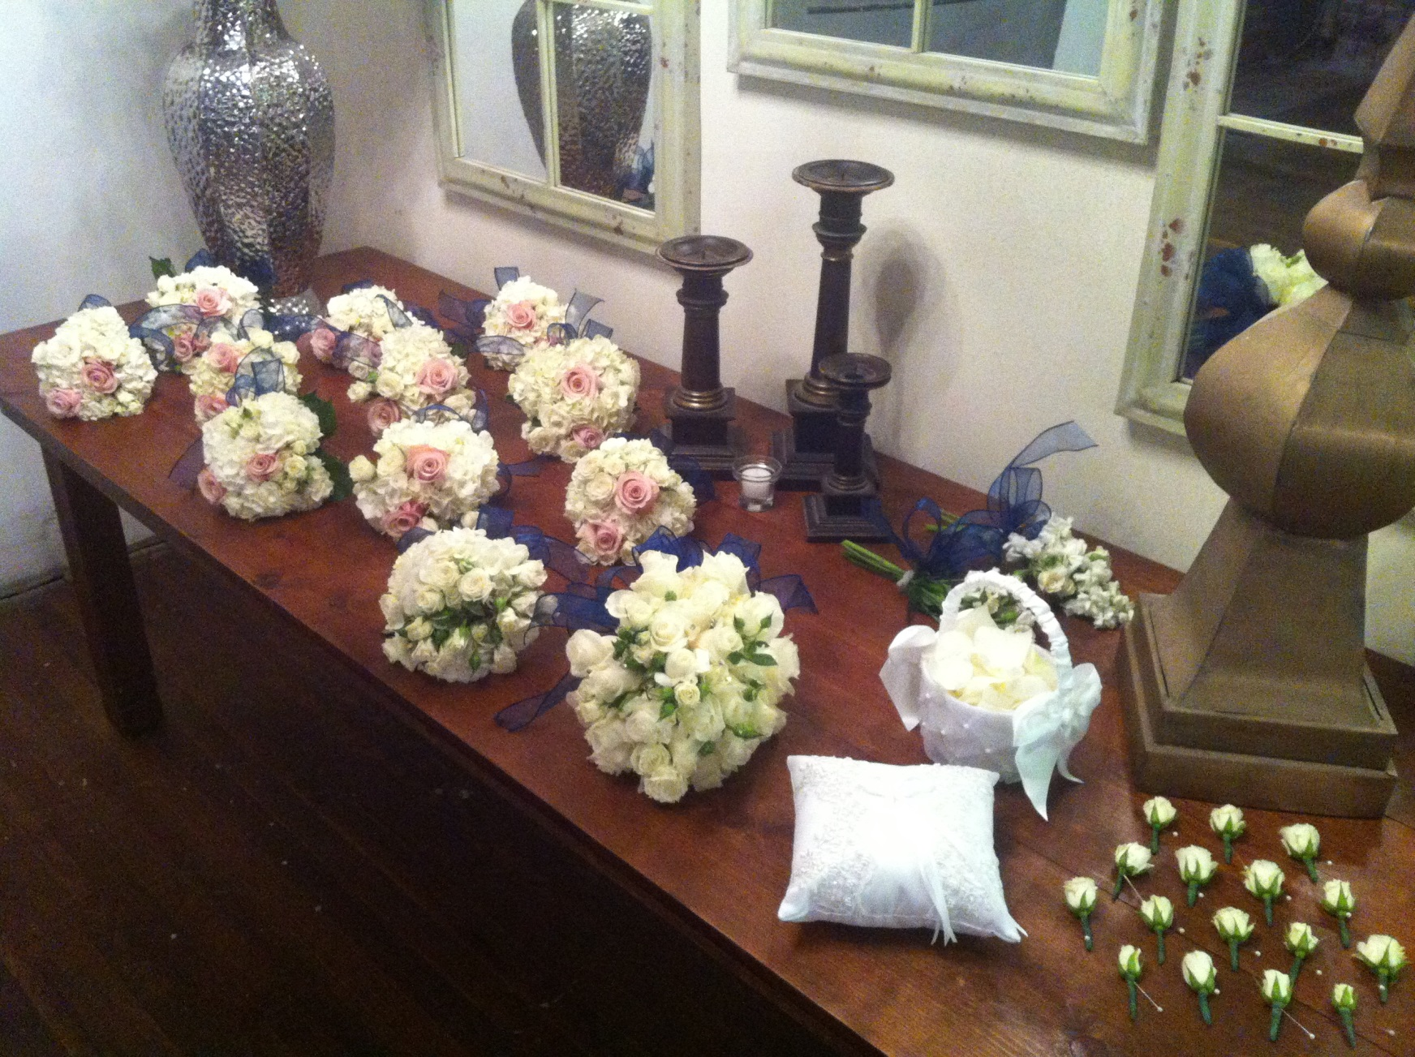
Janet Salisbury & Dakarai Wallace
A Grand Affair –Marvin Jeter & Associates

Slide 7
Janet Salisbury & Dakarai Wallace
A Grand Affair –Marvin Jeter & Associates

Slide 8
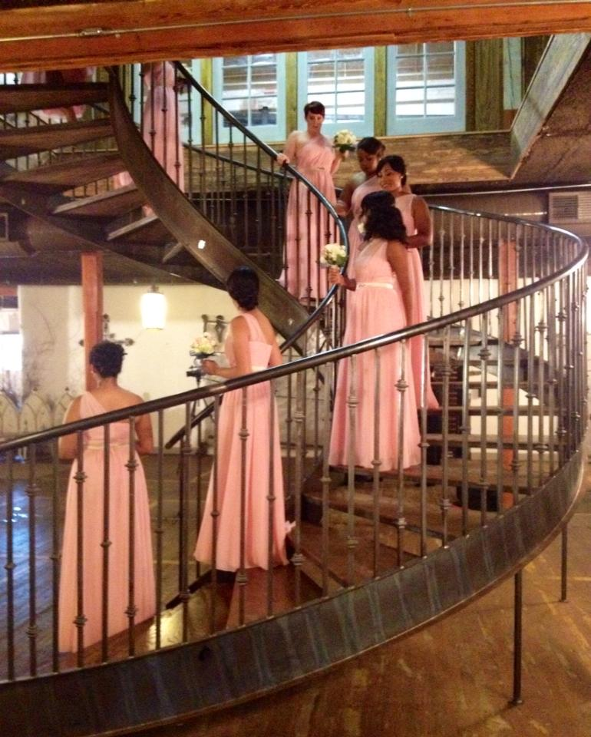
Janet Salisbury & Dakarai Wallace
A Grand Affair –Marvin Jeter & Associates

Slide 9
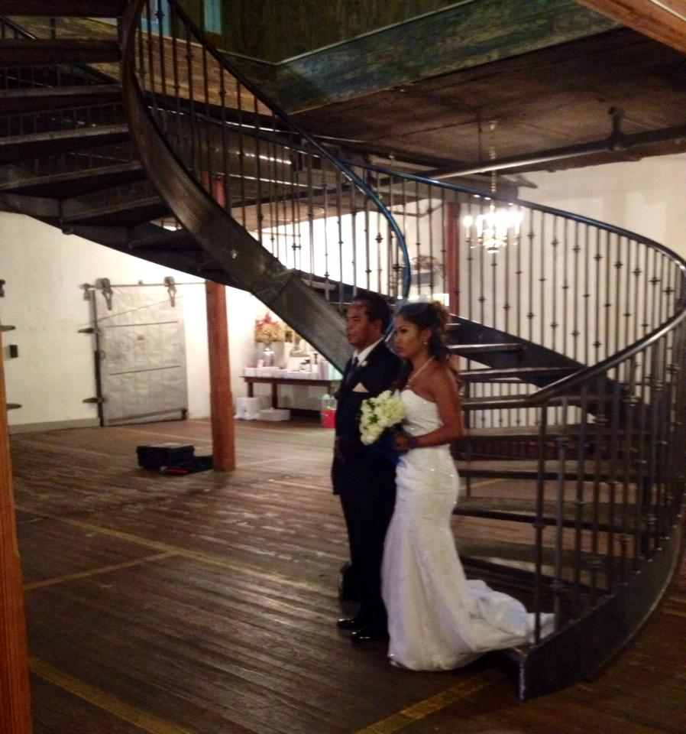
Janet Salisbury & Dakarai Wallace
A Grand Affair –Marvin Jeter & Associates

Slide 10
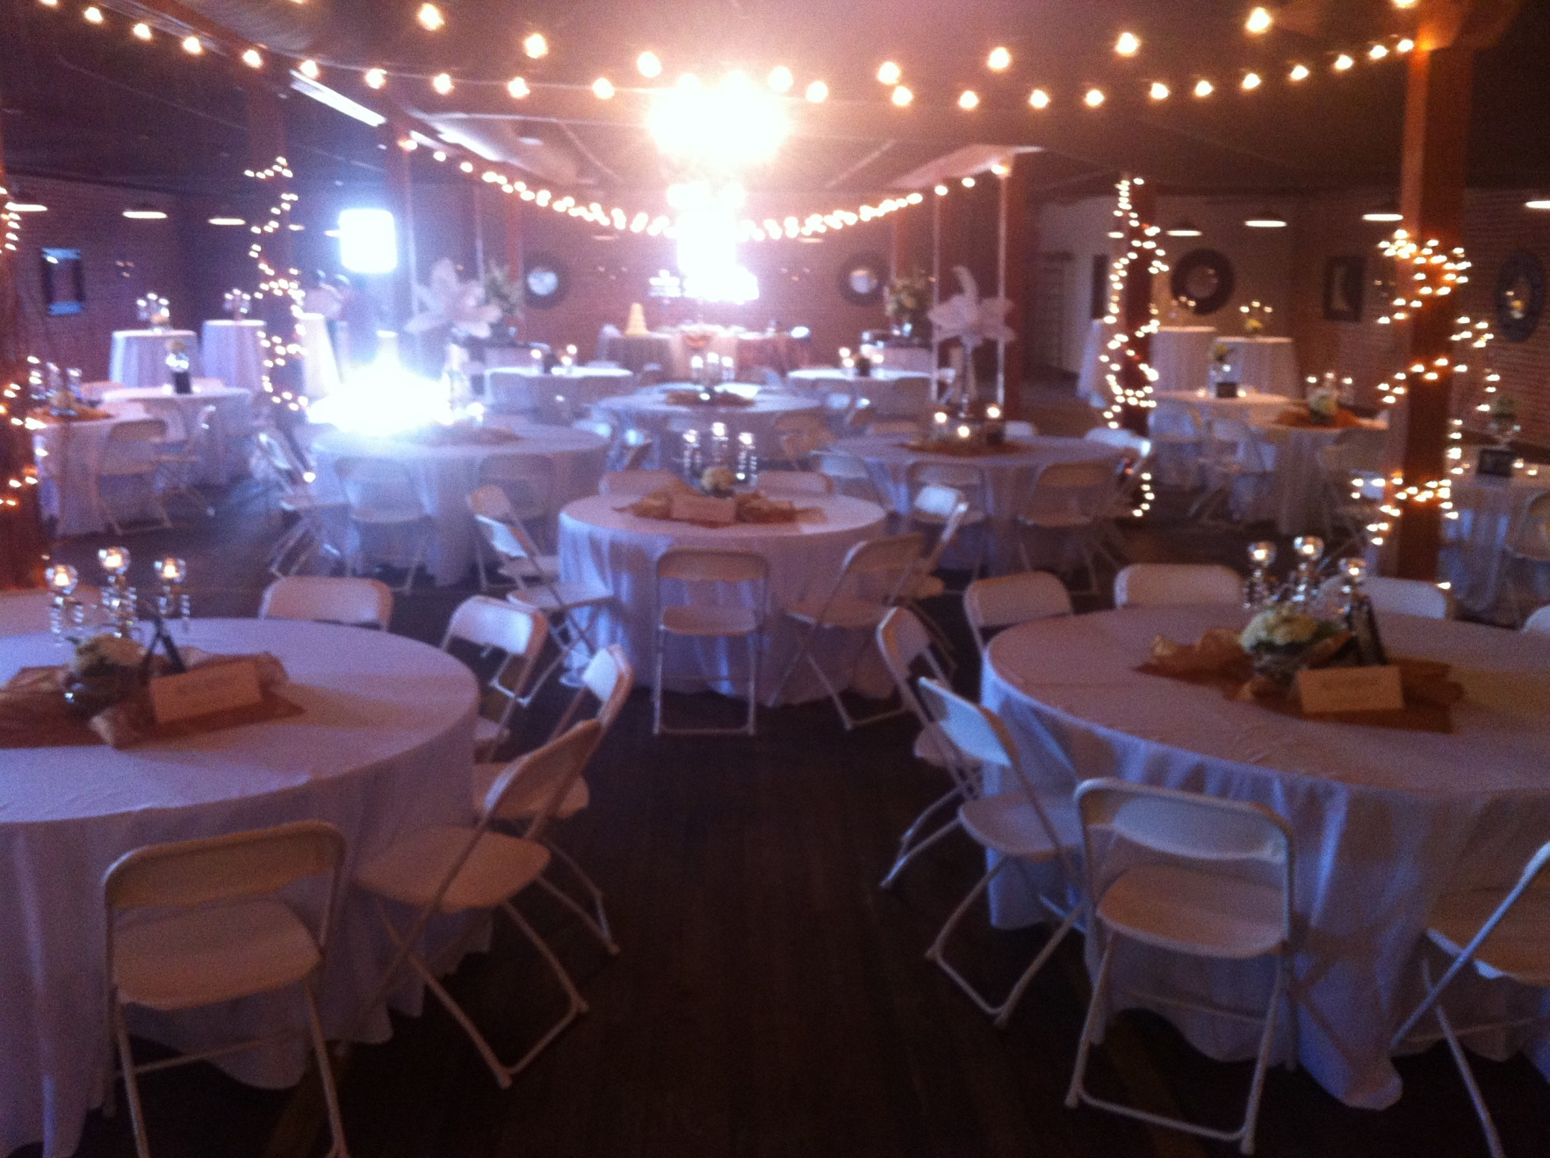
Janet Salisbury & Dakarai Wallace
A Grand Affair –Marvin Jeter & Associates

Slide 11
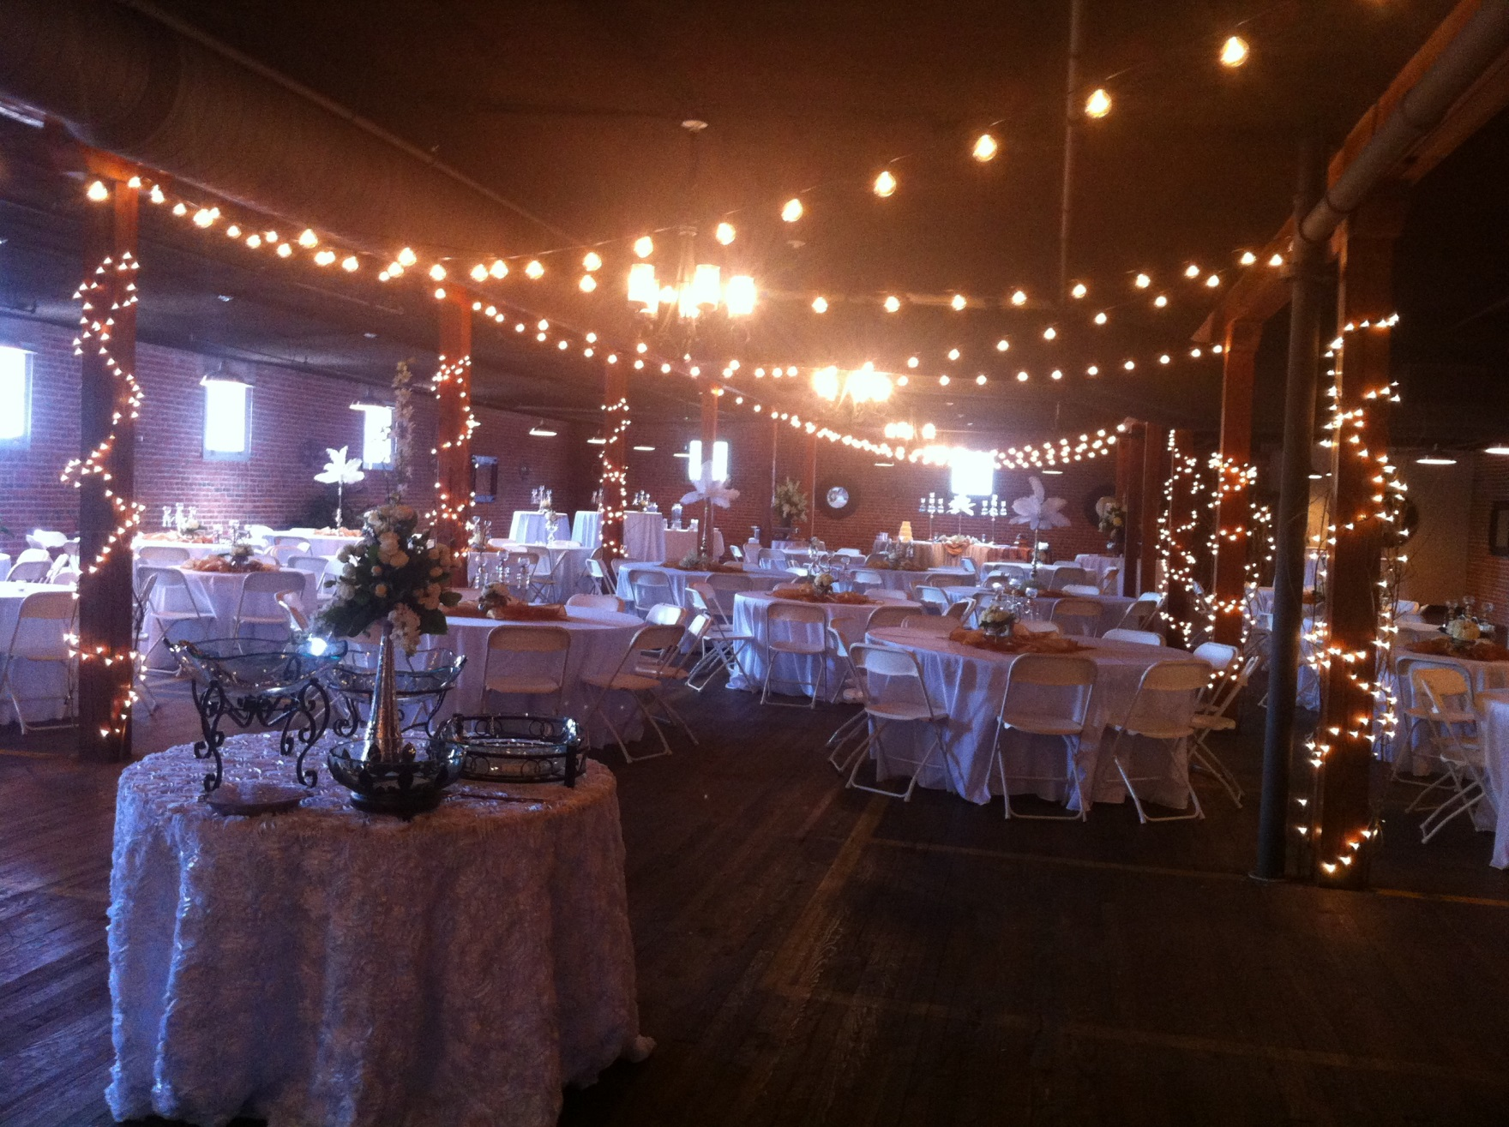
Janet Salisbury & Dakarai Wallace
A Grand Affair –Marvin Jeter & Associates

Slide 12
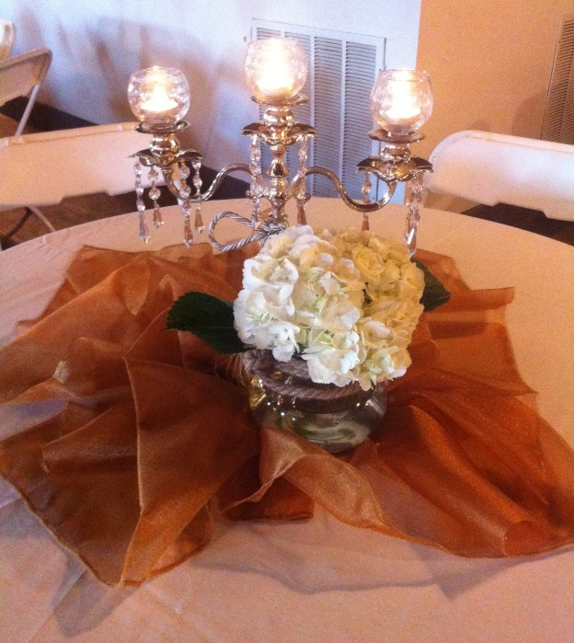
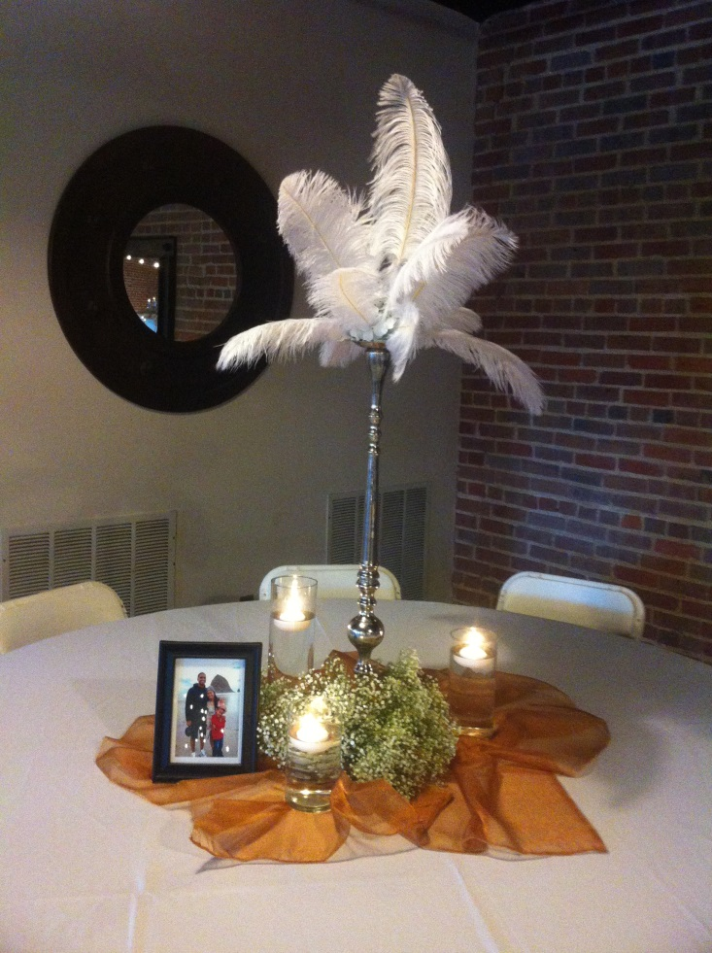
Janet Salisbury & Dakarai Wallace
A Grand Affair –Marvin Jeter & Associates

Slide 13
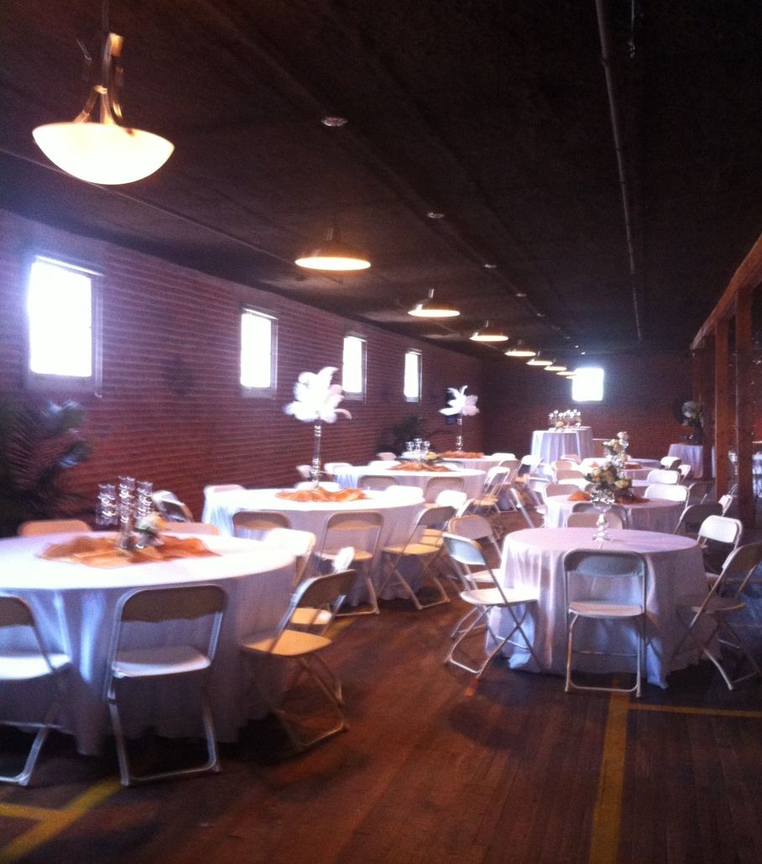
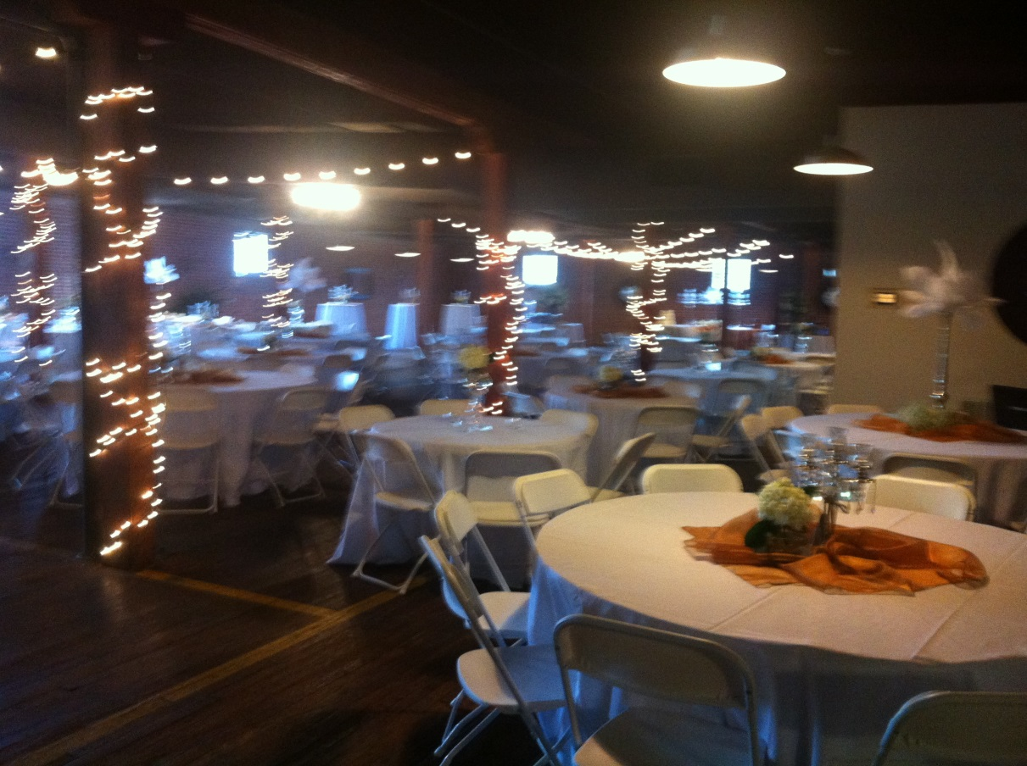
Janet Salisbury & Dakarai Wallace
A Grand Affair –Marvin Jeter & Associates

Slide 14
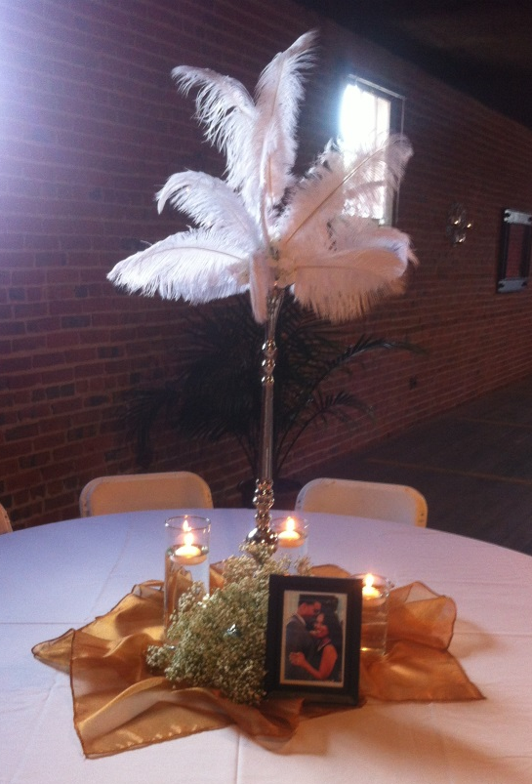
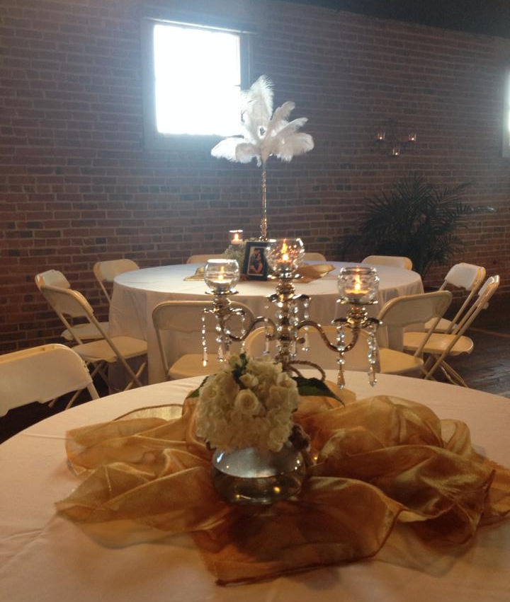
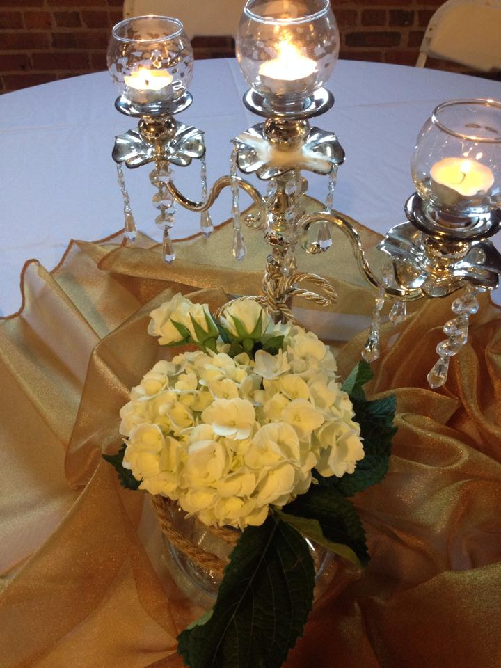
Janet Salisbury & Dakarai Wallace
A Grand Affair –Marvin Jeter & Associates

Slide 15
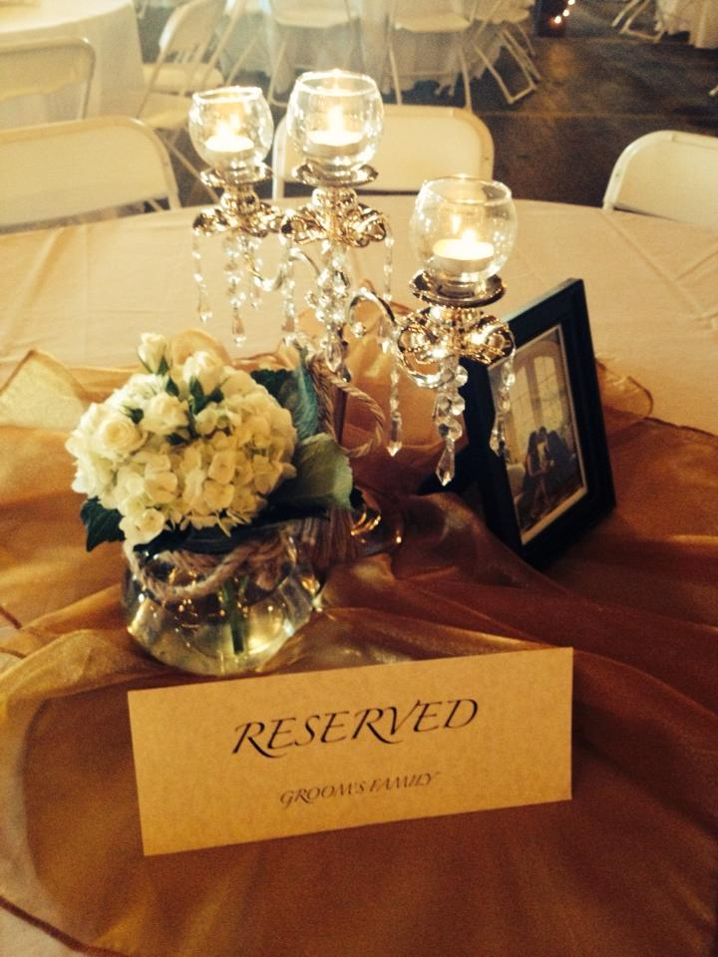
Janet Salisbury & Dakarai Wallace
A Grand Affair –Marvin Jeter & Associates

Slide 16
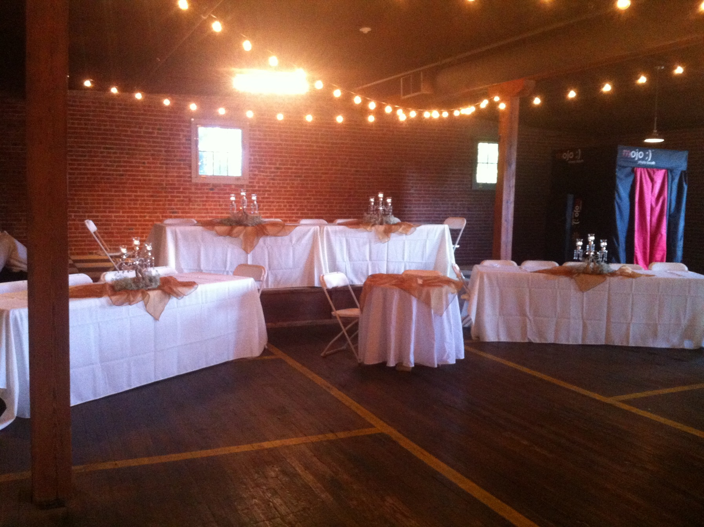
Janet Salisbury & Dakarai Wallace
A Grand Affair –Marvin Jeter & Associates

Slide 17
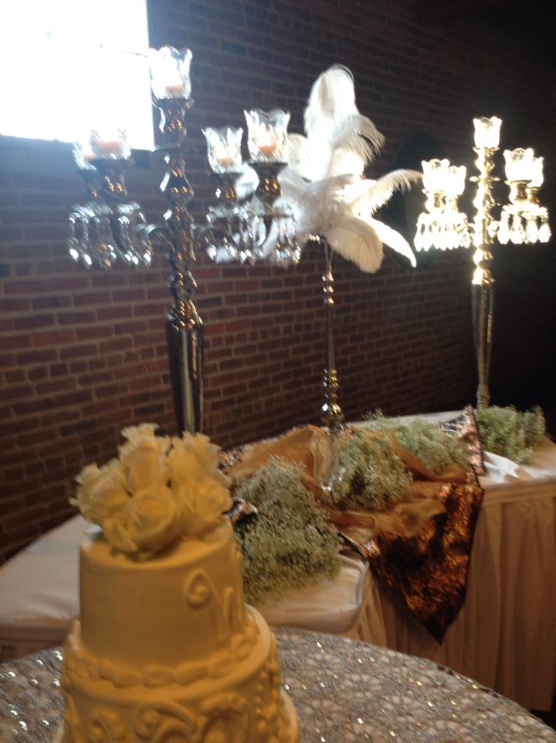
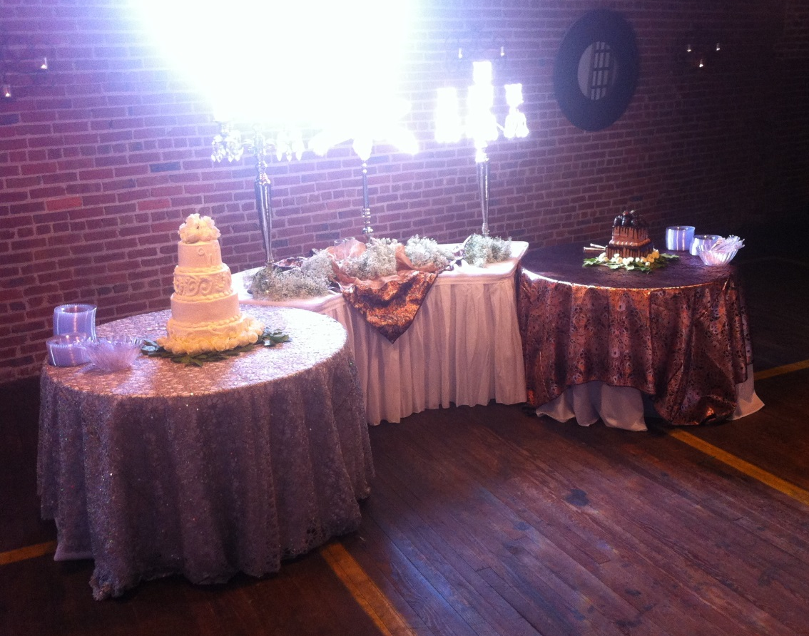
Janet Salisbury & Dakarai Wallace
A Grand Affair –Marvin Jeter & Associates

Slide 18
Janet Salisbury & Dakarai Wallace
A Grand Affair –Marvin Jeter & Associates

Slide 19
Janet Salisbury & Dakarai Wallace
A Grand Affair –Marvin Jeter & Associates

Slide 20
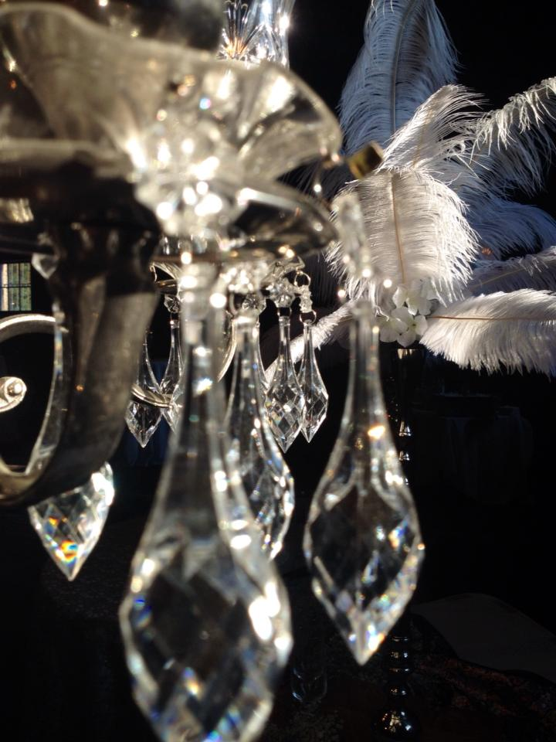
Janet Salisbury & Dakarai Wallace
A Grand Affair –Marvin Jeter & Associates

Slide 21
Janet Salisbury & Dakarai Wallace
Ice House Alley Warehouses
Jackson, Mississippi
September 6, 2014
A Grand Affair –Marvin Jeter & Associates

