Slide 1
Puckett Engagement Party
Private Home
Ridgeland, Mississippi
March 20, 2015
A Grand Affair –Marvin Jeter & Associates

Slide 2
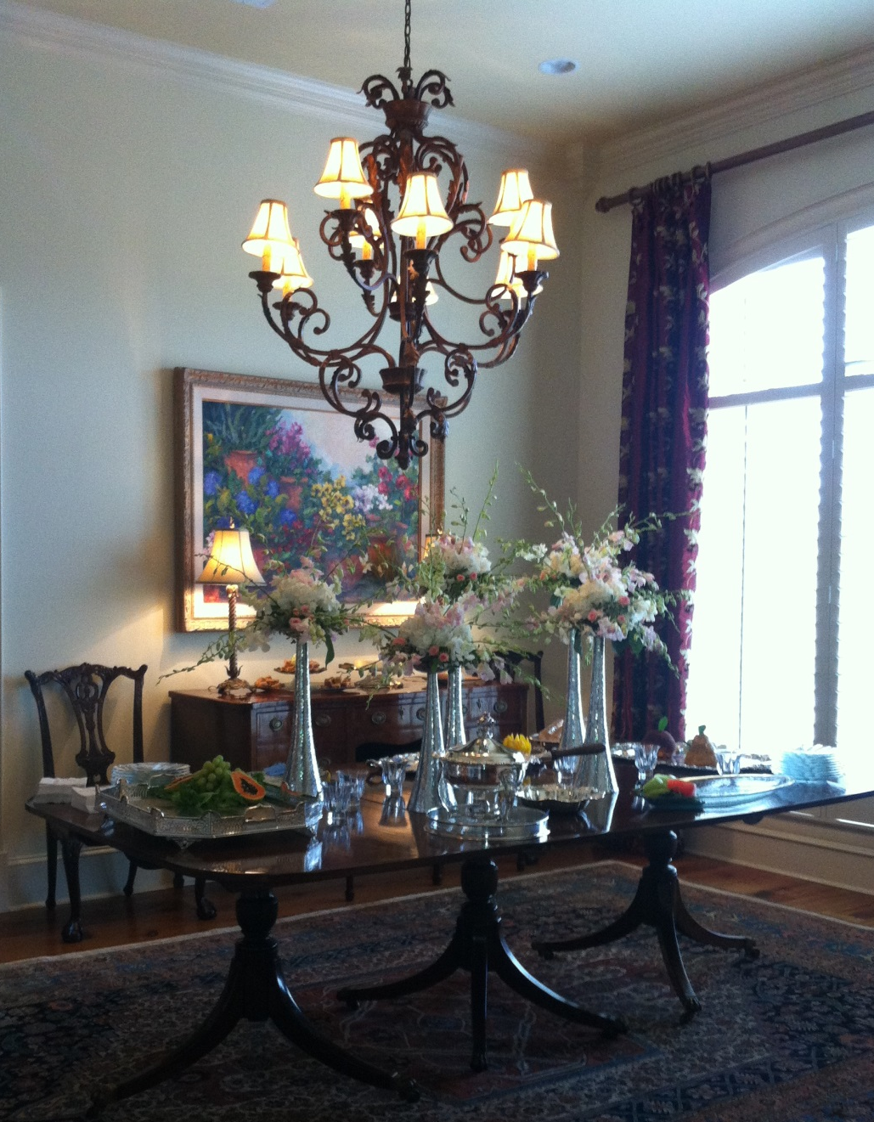
Puckett Engagement
A Grand Affair –Marvin Jeter & Associates

Slide 3
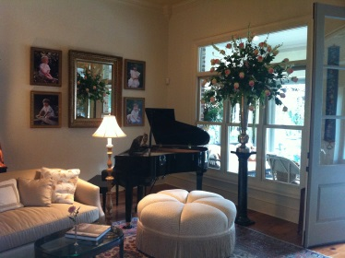
Puckett Engagement
A Grand Affair –Marvin Jeter & Associates

Slide 4
Puckett Engagement
A Grand Affair –Marvin Jeter & Associates

Slide 5
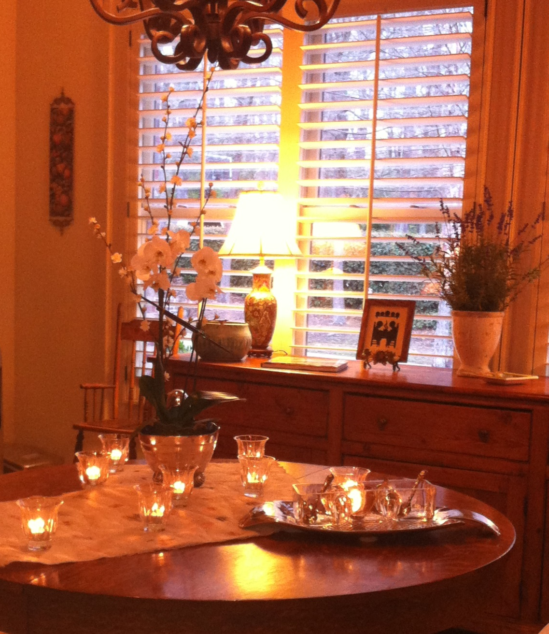
Puckett Engagement
A Grand Affair –Marvin Jeter & Associates

Slide 6
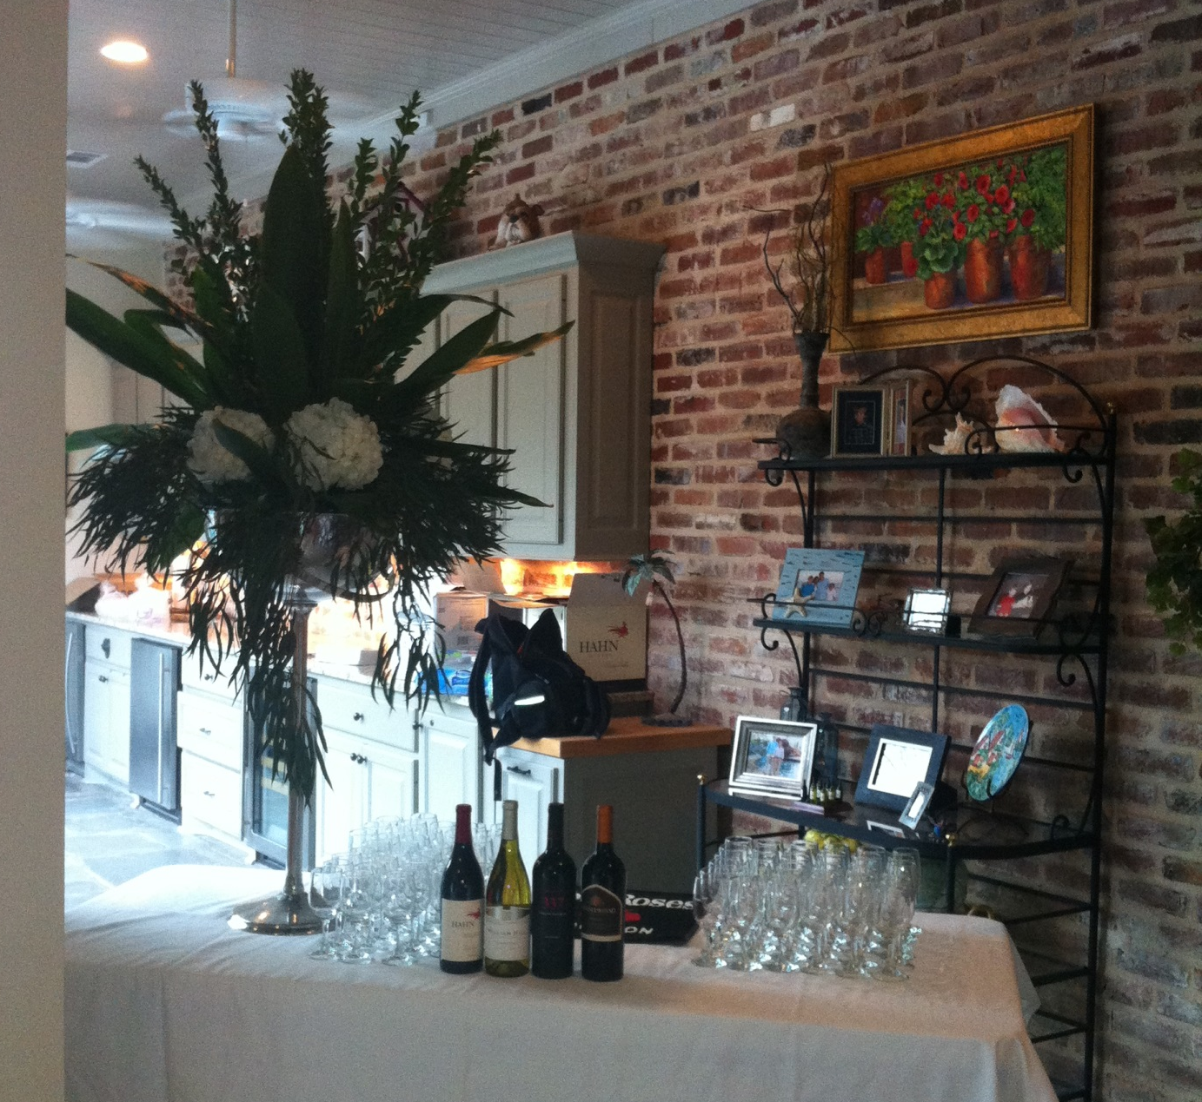
Puckett Engagement
A Grand Affair –Marvin Jeter & Associates

Slide 7
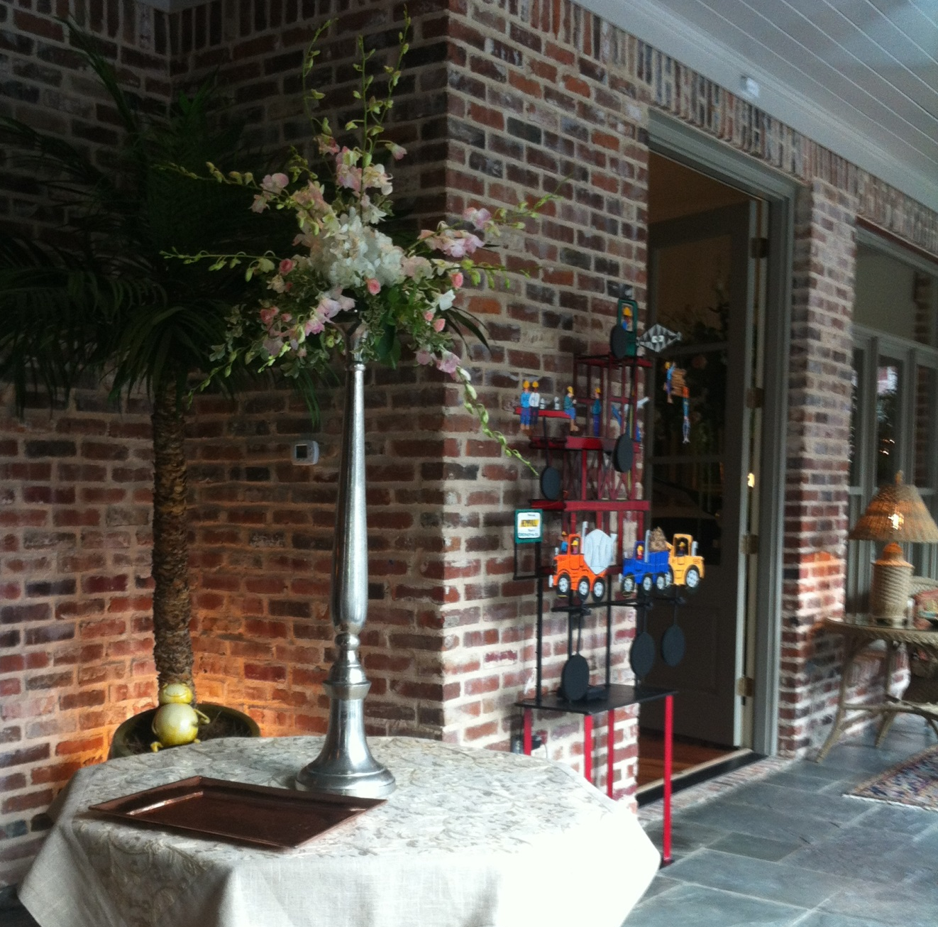
Puckett Engagement
A Grand Affair –Marvin Jeter & Associates

Slide 8
Puckett Engagement Party
Private Home
Ridgeland, Mississippi
March 20, 2015
A Grand Affair –Marvin Jeter & Associates

